Slide 1
“besigo” Kelemen MLT full spectrum lens simulator.
Hajime UCHIMURA / nikq

Slide 2
besigo?
娘(2歳)、最近になり日本語が楽しくて仕方ないらしい
新しい単語を思いつくと気に入って繰り返す
最近は「べしご！」
以前は「がじゃい！」
記念なのでレンダラーの名前に使った。

Slide 3
specialities
Fullspectrum
supports RGB>Spectrum by Smits’
support blackbody emitters.
KelemenMLT(pt)
Real lens simulation
with autofocus ☺
SPH simulated fluid models from Blender.

Slide 4
Differ from past
Past year, the lens simulation was limited to only one direction.
No reflection, no ghosts, no flares.
This year, everything is simulated.
Based on Fresnel reflection.
done with KelmenMLT.
very hard without MCMC.
Raytracing is done with Embree. My interest is on just lenses!

Slide 5
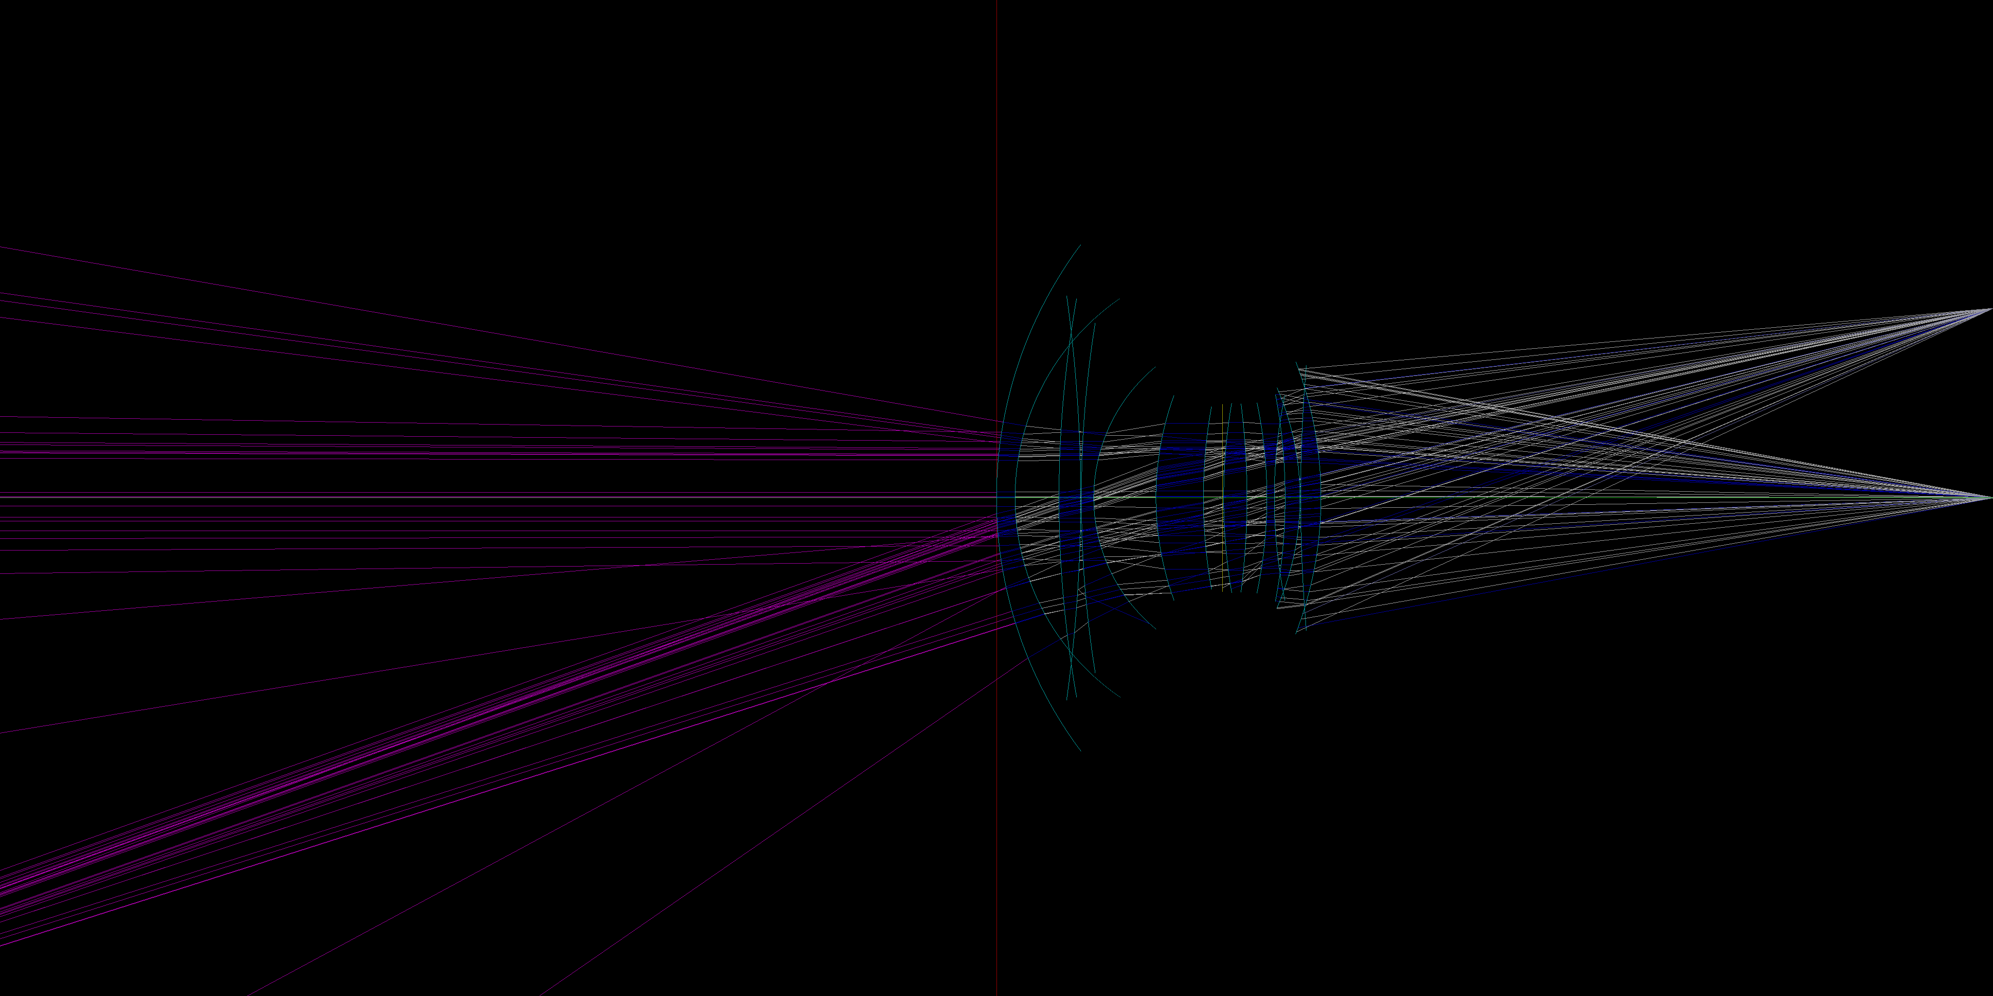
example.(ELMARIT28/2.8)

Slide 6
Original lens format that supports backfrange, image circle, roughness.
C 35
SZ 60.5 6.84462668188714E-03 11.6999998092651 1.799520 42.09
SZ 60.5 1.71909915594792E-03 .200000002980232 1 1
SZ 50.5 1.08342358281315E-02 10.3000001907349 1.67003 47.2
SZ 50.5 6.09756097560976E-03 .200000002980232 1 1
SZ 43.0 1.84162065202661E-02 24.3999996185303 1.6935 53.4
SZ 43.0 -3.28623082522222E-03 0 1 1
SZ 43.0 -3.28623082522222E-03 6.30000019073486 1.7552 27.5
SZ 28.0 3.31125819449372E-02 17 1 1
I 25 0 9.60000038146973
SZ 28 -2.16450212875792E-02 4 1.5927 35.27
SZ 28 8.00640502628659E-03 0 1 1
SZ 28 8.00640502628659E-03 14.5 1.7859 44.17
SZ 28 -0.013736263160443 0.200000002980232 1 1
SZ 34.5 8.24402287585521E-03 11.6000003814697 1.7859 44.17
SZ 34.5 -7.67459690390627E-03 38.4850481401564 1 1

Slide 7
KelemenMLT is based on hole-san’s simplemlt.
simplemlt is god.
Tried to implement Disney principled BRDFs but time’s up.

Slide 8
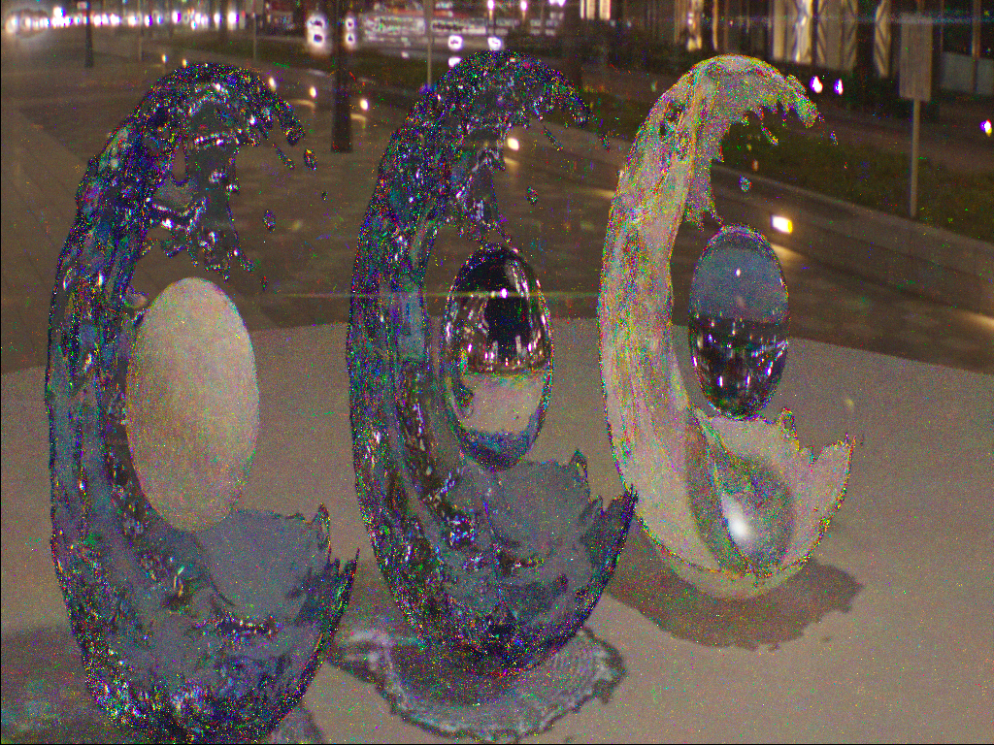
Roughness?
To achieve anamorphic flares.

Slide 9
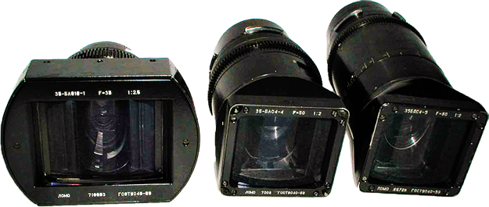
Anamorphic lenses are used mostly for cinema cameras to enwide FOV.
reference > http://www.pronews.jp/column/raitank/1112291230.html

Slide 10
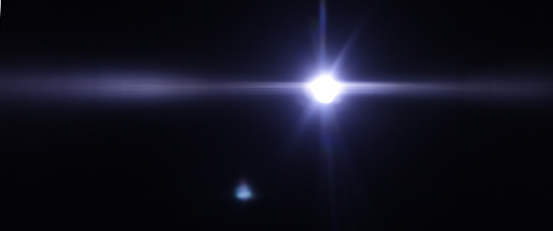
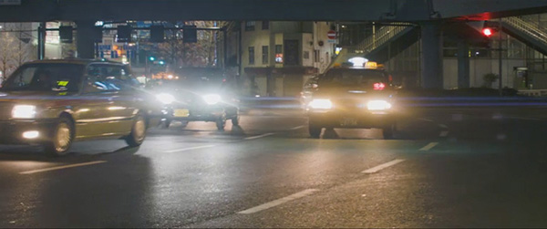
Horizontal flares are very pouplar with anamo-lens.
reference > http://cgcompo.blog134.fc2.com/blog-entry-56.html

Slide 11
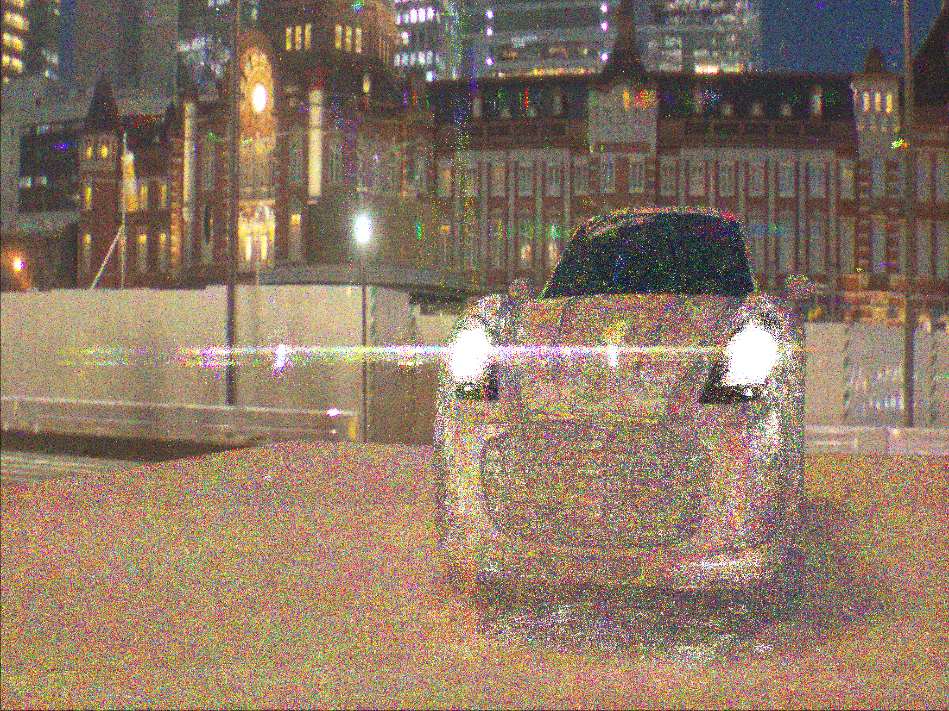
YEAH.

Slide 12
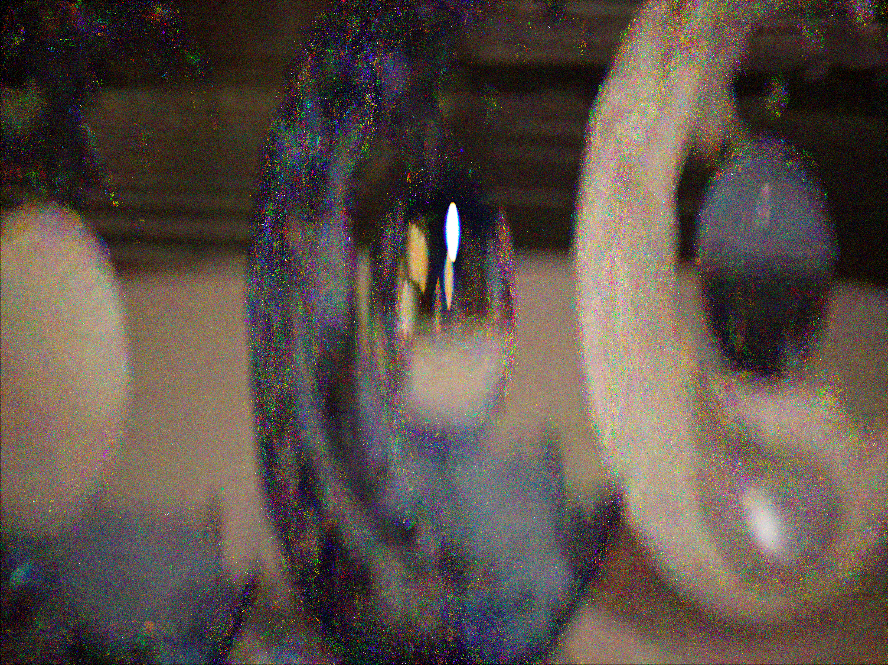
I couldn’t get smooth horizontal flares without roughness.

Slide 13
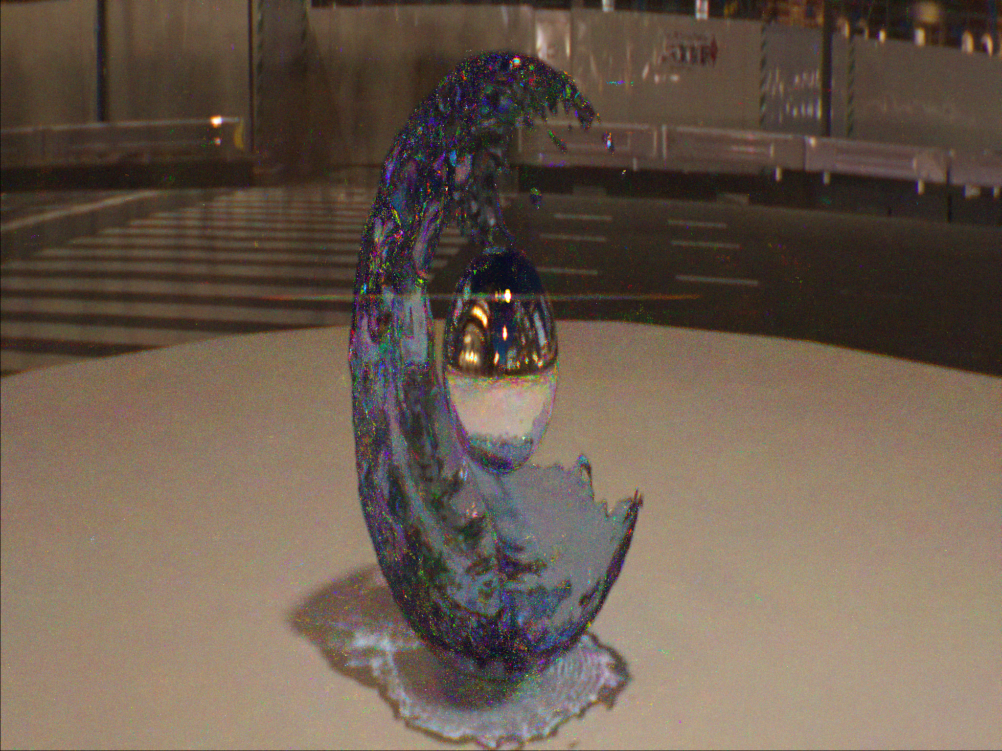
normal vector goes random with roughness probability.

Slide 14
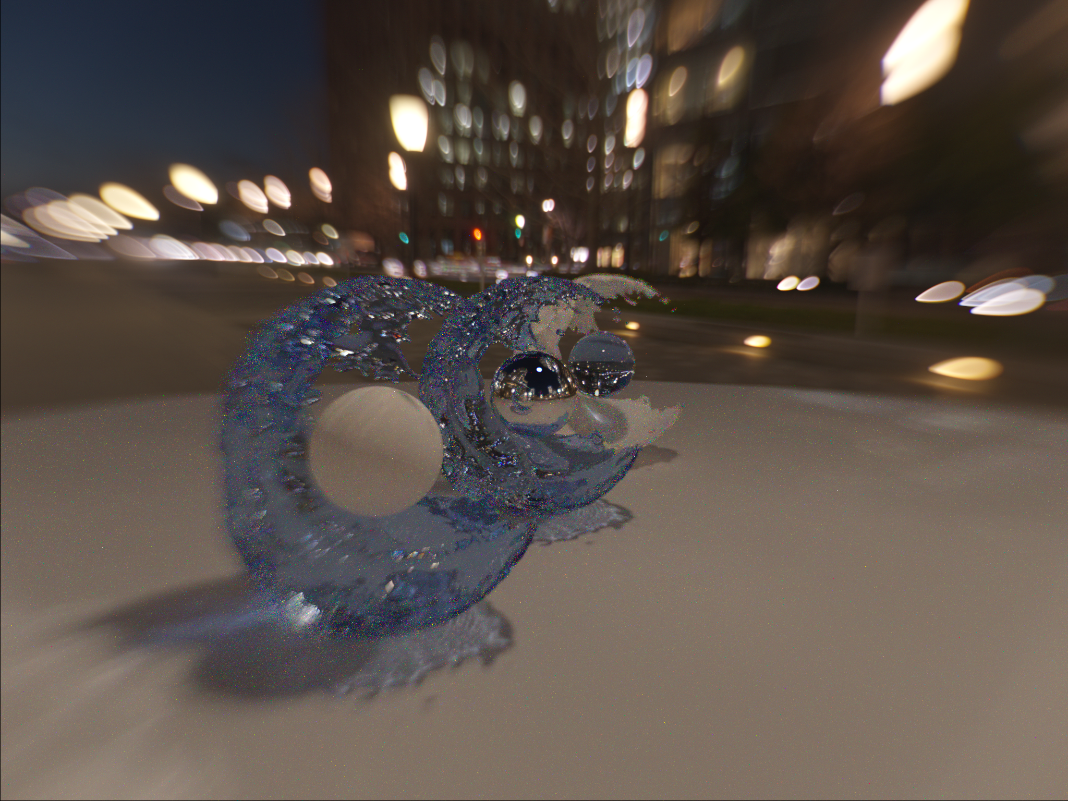
Other examples.
Non uniform DoF circles.

Slide 15
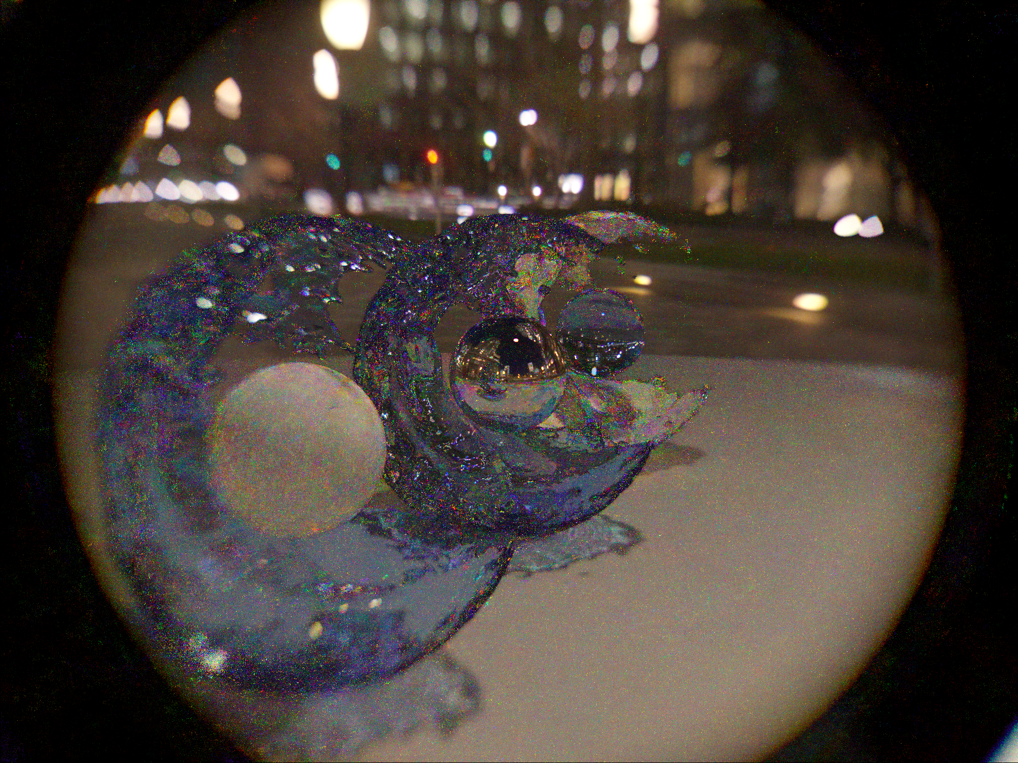
DoF circle kick-out

Slide 16
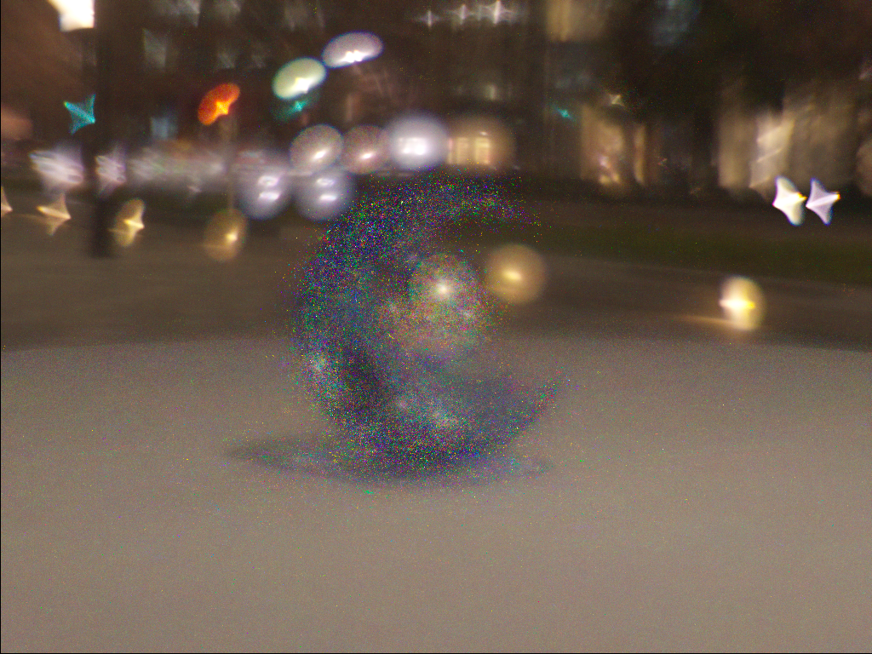
astigmatism

Slide 17
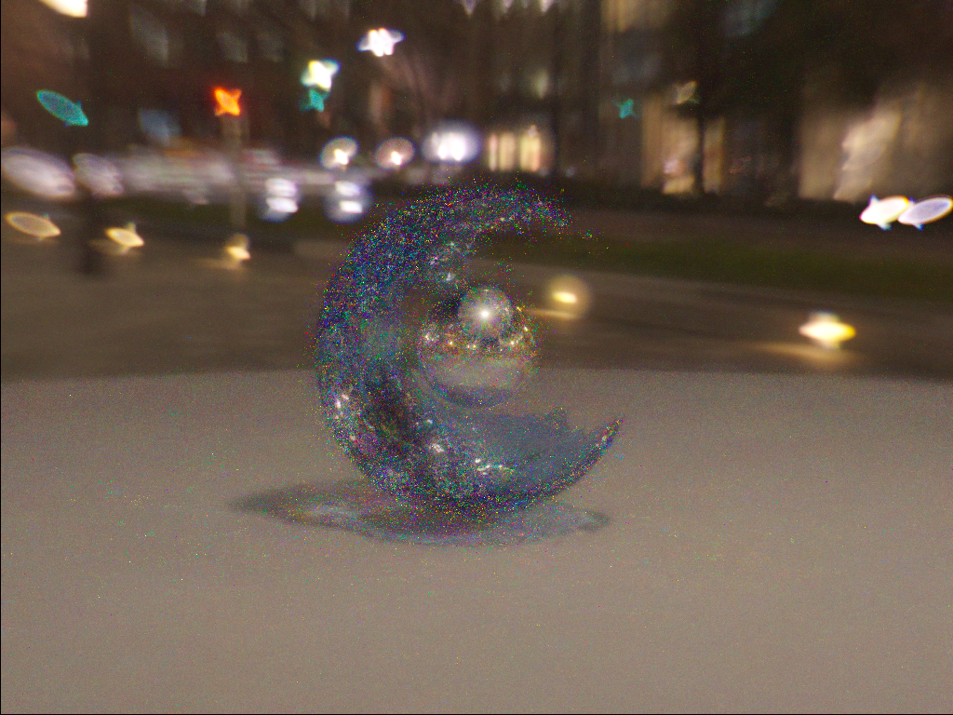
halo

Slide 18
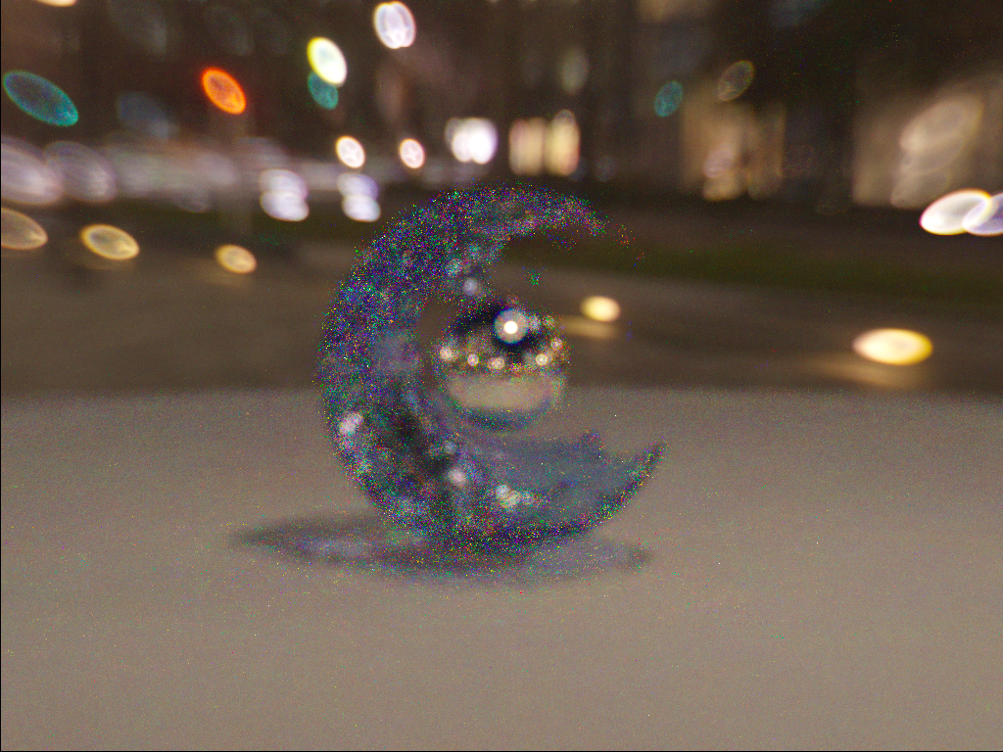

Slide 19
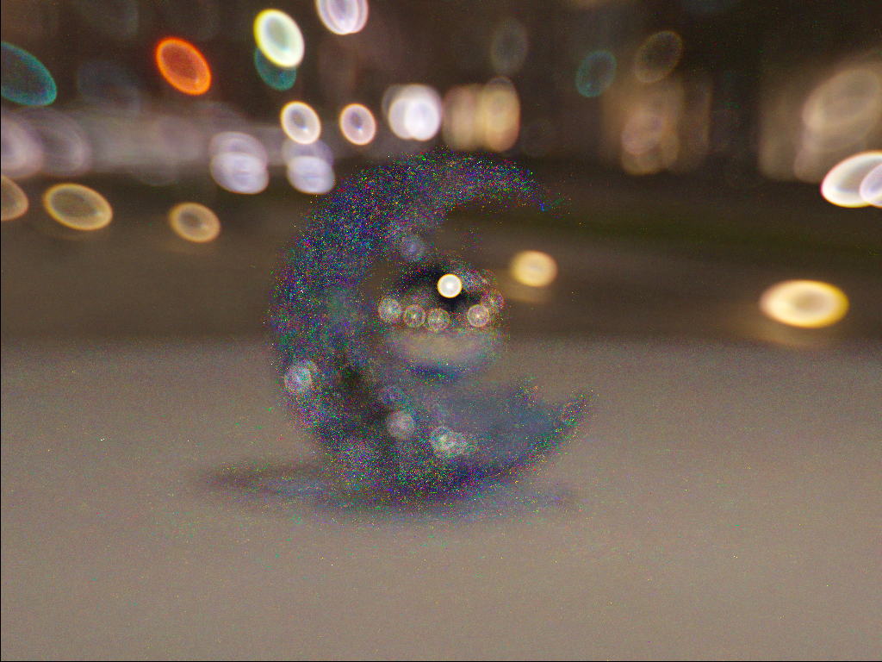
DoF fringes.

Slide 20
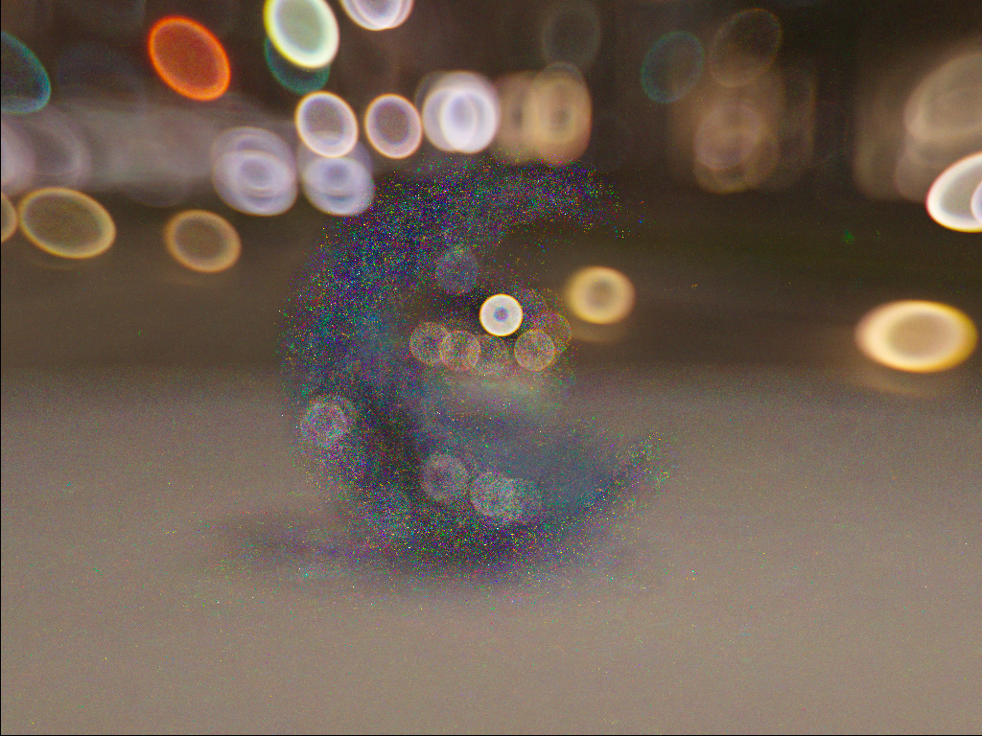

Slide 21
RGB>Spectrum is done with Smit’s method.
"An RGB to Spectrum Conversion for Reflectances," Journal of Graphics Tools, Vol. 4, No. 4, pp. 11-22, 1999.
algorithm is very simple.
maximum component makes base spectrum.
remains make complementary colors

Slide 22
Mesh smooth normal
mesh smooth normal is calculated from vertex normal averages.

Slide 23
fail samples.

Slide 24
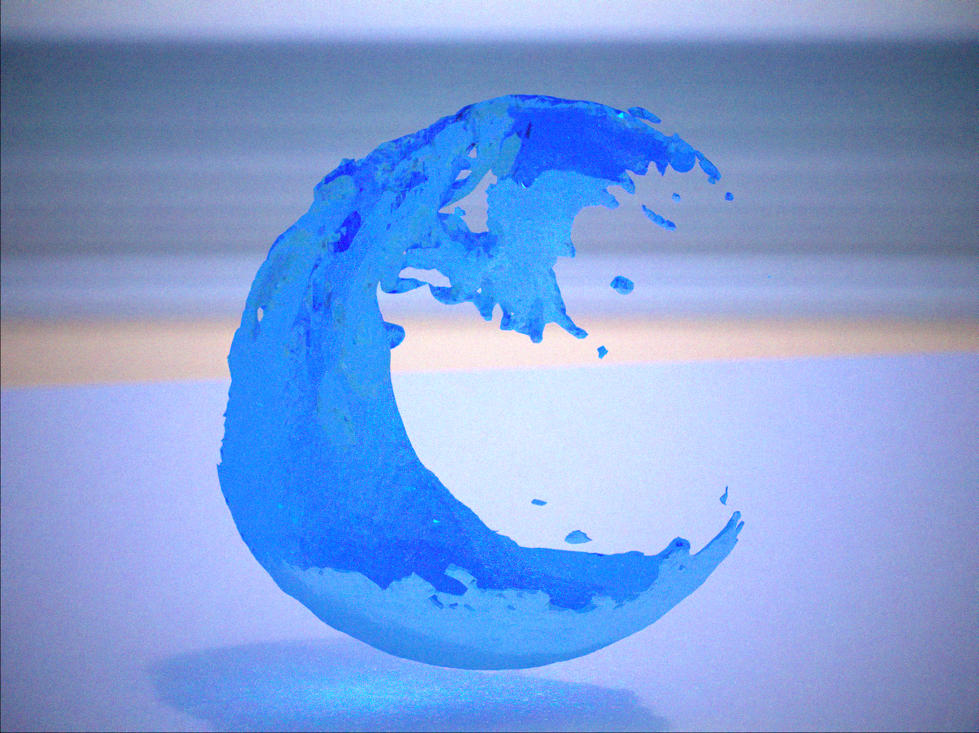
buggy refract.

Slide 25
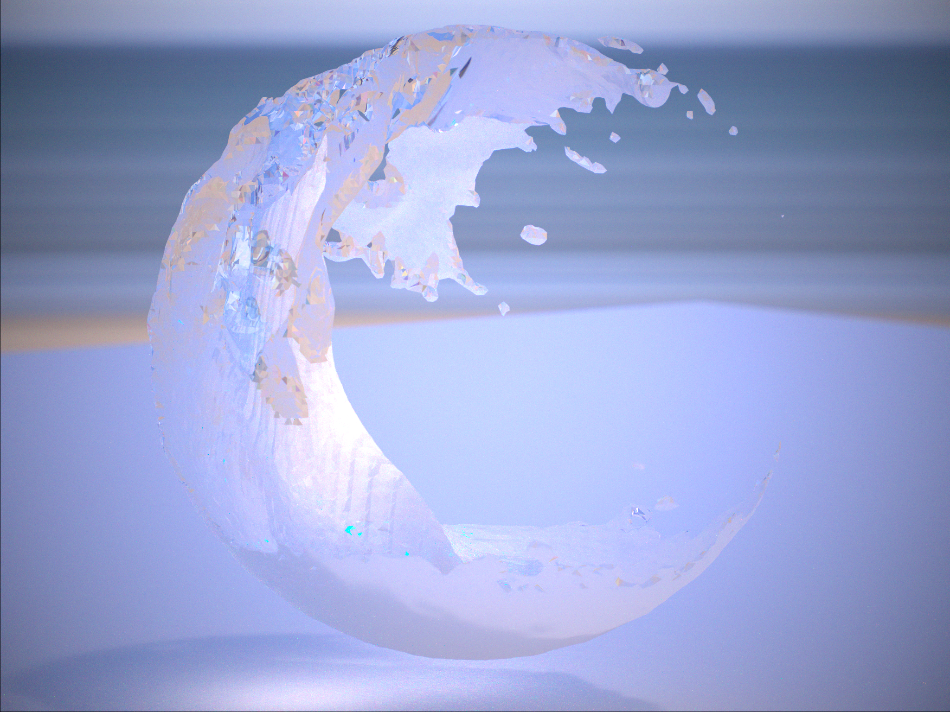
refraction bug

Slide 26
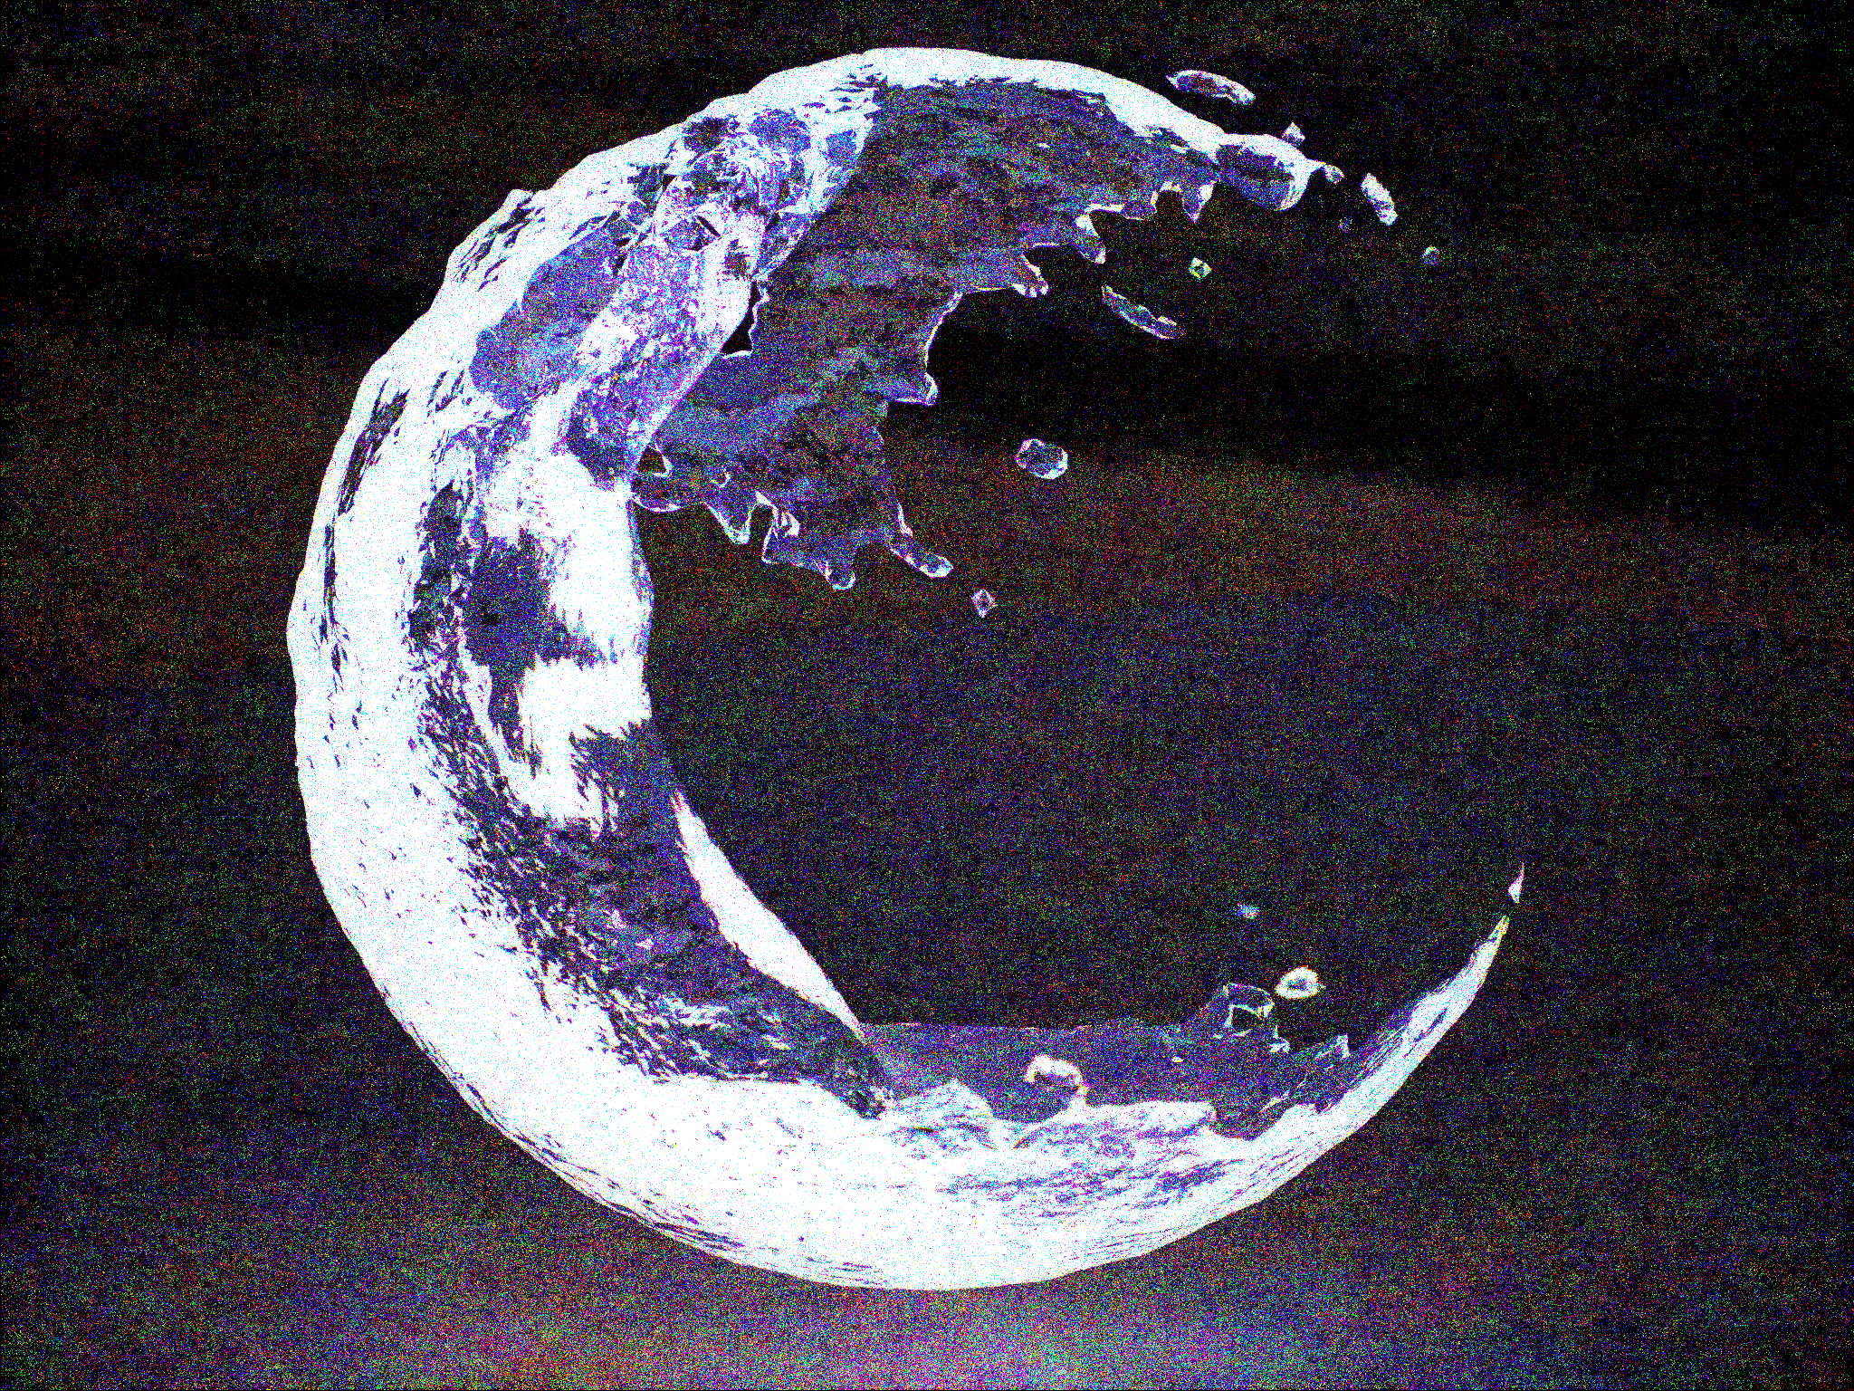
total-reflection bug

Slide 27
conclusion.
Got “eye-candy” lens bokehs from actual patented lenses with
full spectrum effects like purple/green fringes, etc..
HDR background makes everything good.
Real lens simulation is very fun!
Thank you my family!!

